Slide 1

Capstone Project

Slide 2

Personal BACKGROUND
(Name, Past Experience, Qualification, Career Summary)
Name : Boddukuri Shrenika
Past Experience : Fresher
Qualification : B.Tech IT
Career Summary : I am a student recently joined Ascendion as Fresher

Slide 3

Key Takeaways/Learnings from the Program (HTD)
During this training program, I significantly advanced my expertise in frontend and backend web technologies, gaining comprehensive, hands-on experience with Angular, React, and MongoDB.
I deepened my understanding of Angular by mastering module and standalone component architecture, learning best practices for state management with NgRx, and implementing advanced features for robust, scalable applications. The practical sessions on routing, form validations, and optimization principles helped build projects with maintainable and high-performance frontends.
Through focused React training, I developed proficiency in hooks, functional components, and advanced design patterns. These skills empowered me to create responsive UIs and efficiently manage state and side effects, while also improving error handling and testing strategies for reliability

Slide 4
Key Takeaways/Learnings from the Program (HTD)
On the backend, I built REST APIs using Node.js and Express, emphasizing modular design and secure authentication flows. Integrating MongoDB, I learned data modeling, aggregation, and performance optimization, which enabled me to deliver dynamic, scalable database-driven applications.
Throughout the course, hands-on mini projects and a full-stack capstone challenged me to combine frontend and backend skills, address real-world requirements, and troubleshoot integration issues. These experiences improved my end-to-end development capabilities—from UI logic to database operations—giving me the confidence to plan, implement, and deploy complete applications utilizing modern JavaScript frameworks and NoSQL database.
Throughout the course, hands-on mini projects and a full-stack capstone challenged me to combine frontend and backend skills, address real-world requirements, and troubleshoot integration issues. These experiences improved my end-to-end development capabilities—from UI logic to database operations—giving me the confidence to plan, implement, and deploy complete applications utilizing modern JavaScript frameworks and NoSQL database

Slide 5
Problem Statement of the Capstone Project
Modern insurance management systems often suffer from fragmented user experiences, lack of security, and inefficient policy, claim, and payment handling across various user roles. There is a need for an integrated, scalable, and secure web solution that simplifies core insurance operations for customers, agents, and administrators, while adhering to enterprise requirements for reliability and maintainability. This project aims to deliver a lightweight insurance management application, where users can authenticate, view and purchase policies, submit claims, track payments, and allow agents/admins to process backend workflows within a unified platform

Slide 6
Problem Statement of the Capstone Project
Key challenges addressed include seamless user authentication and authorization, real-time policy management, claim submission and processing, accurate payment recording (excluding live gateways), agent assignment, and system audit logging. The solution emphasizes security (JWT authentication, role-based access), scalability (stateless backend, connection pooling, indexed queries), and maintainability (modular codebase, testing, CI/CD-ready structure). The application will leverage Angular for the frontend, Node.js/Express for the backend, and MongoDB for persistent storage, providing a demonstrably robust MVP for practical insurance workflows

Slide 7
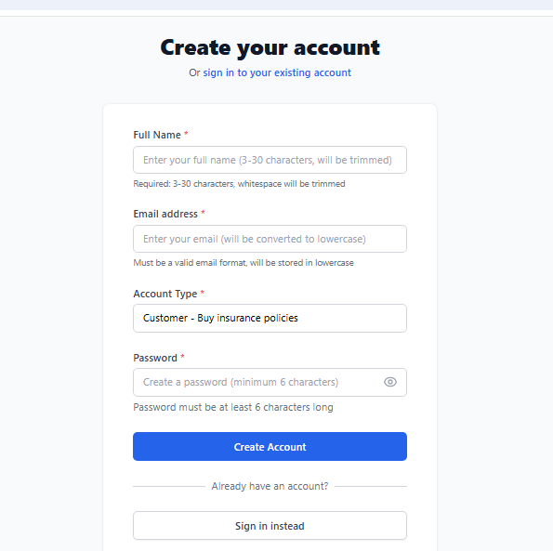
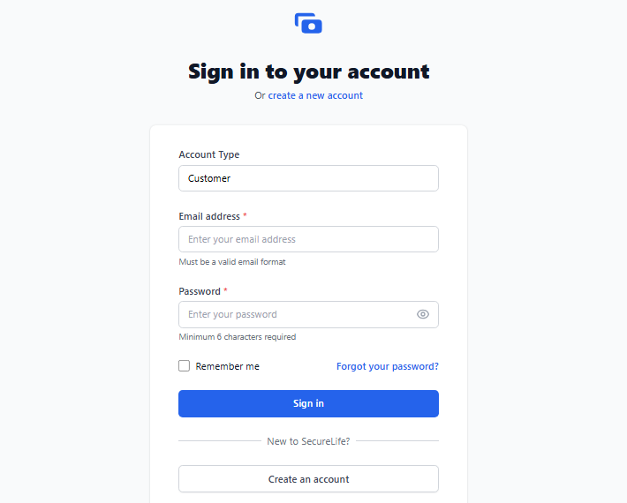
SIGN UP & LOGIN
Important areas of the Project with screenshots

Slide 8
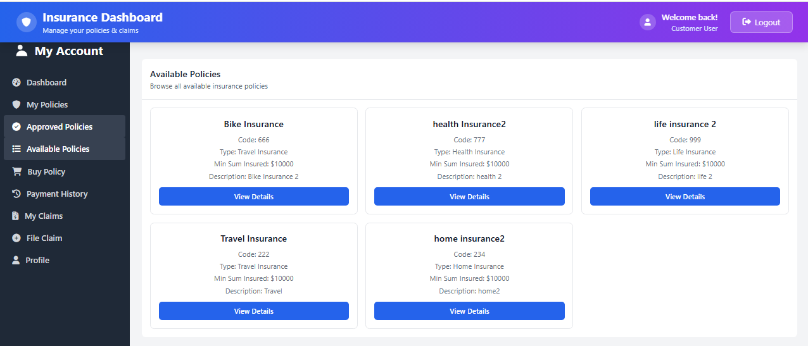
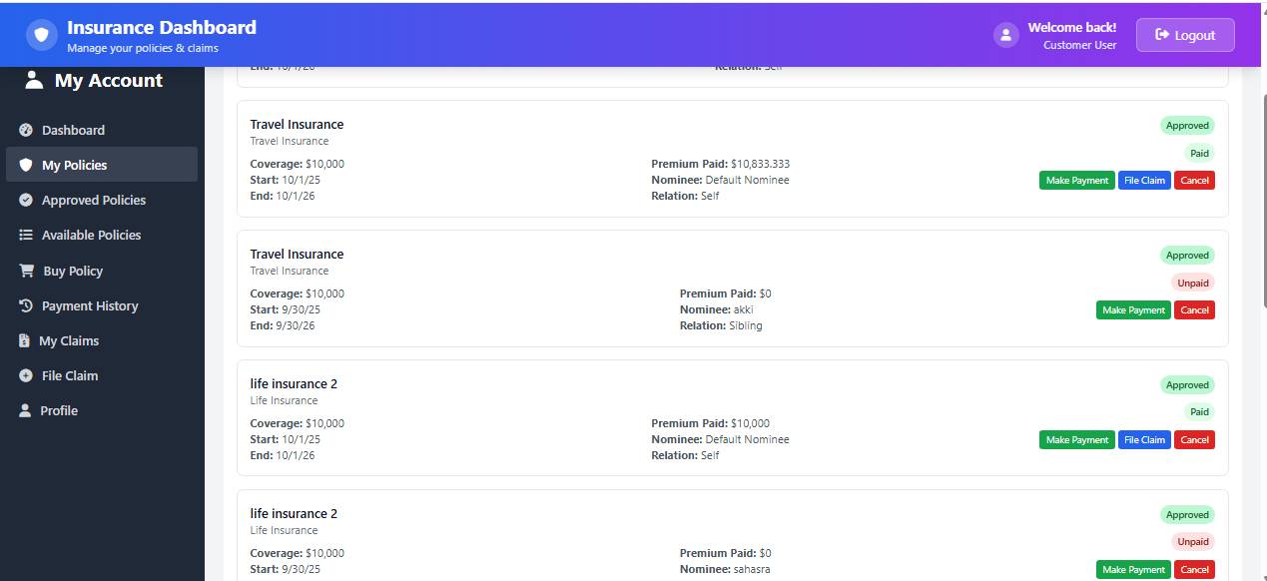
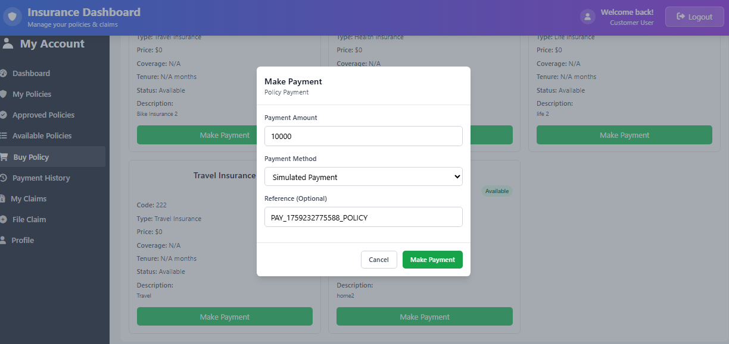
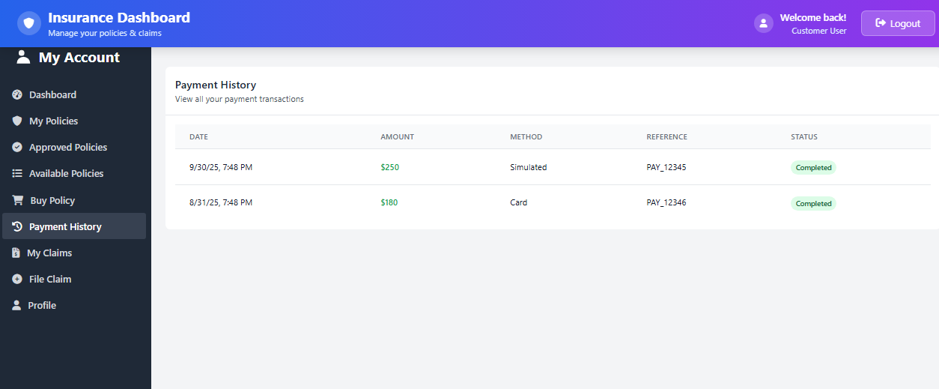
CUSTOMER PORTAL
Important areas of the Project with screenshots

Slide 9
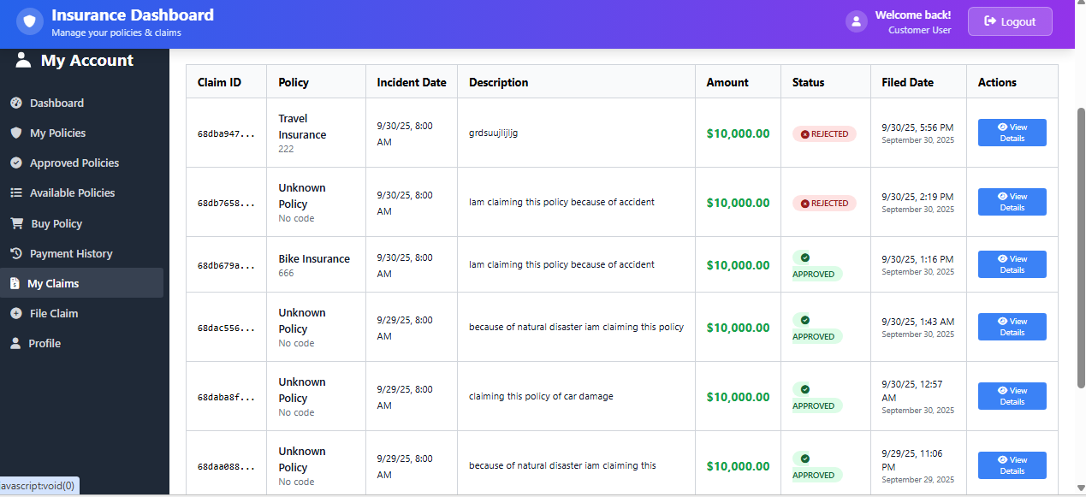
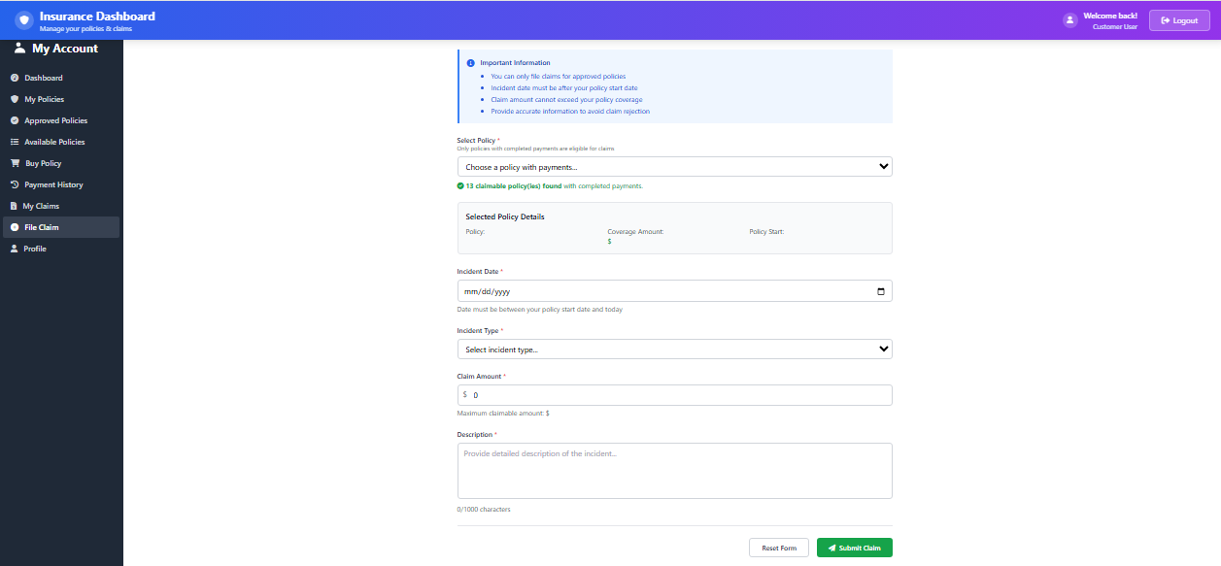
CUSTOMER PORTAL - CLAIMS
Important areas of the Project with screenshots

Slide 10
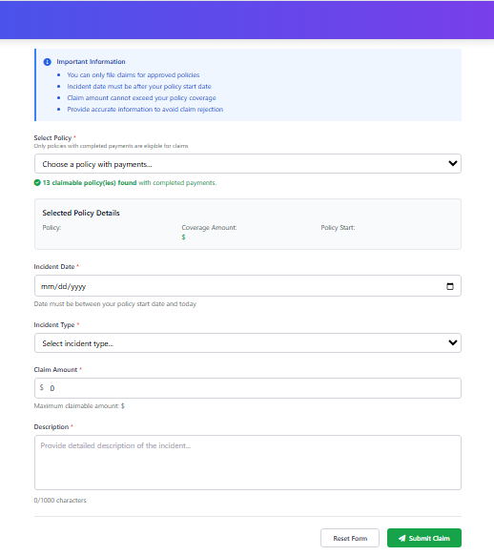
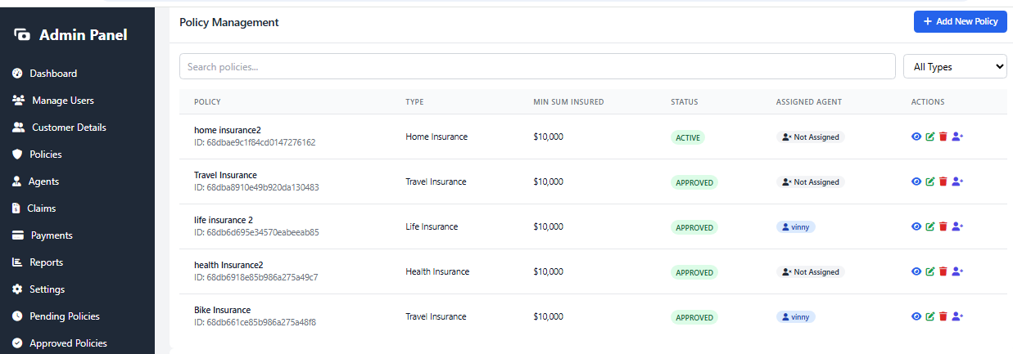
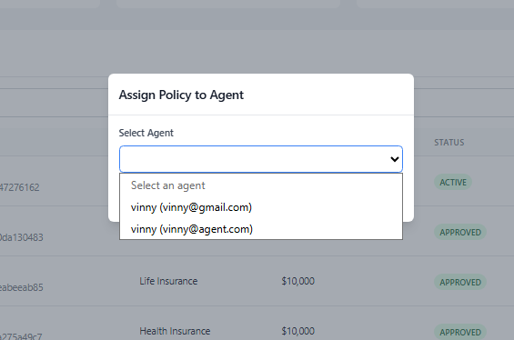
ADMIN PORTAL
Important areas of the Project with screenshots

Slide 11
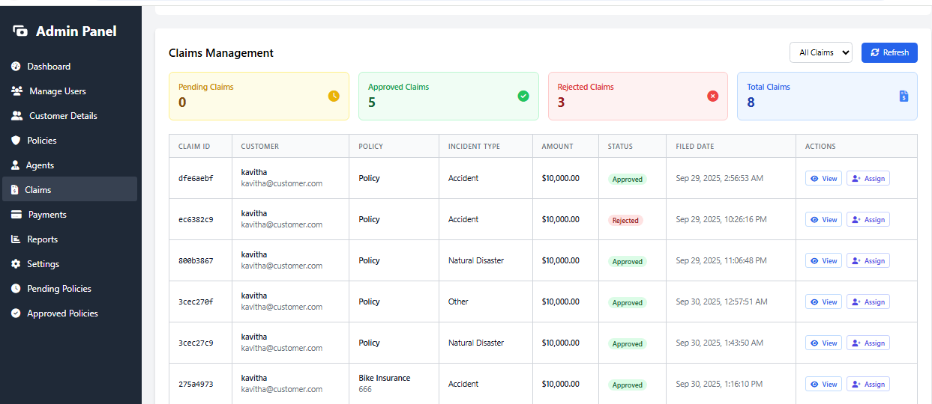
ADMIN CLAIMS
Important areas of the Project with screenshots

Slide 12
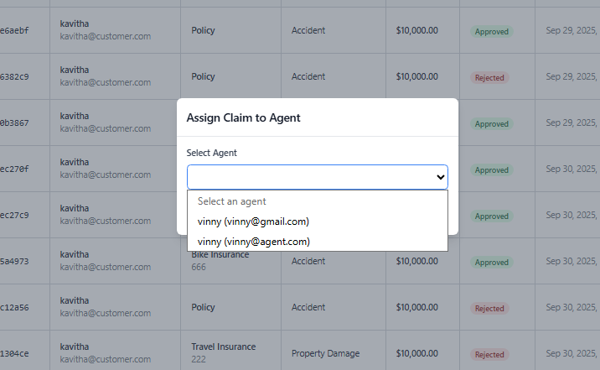
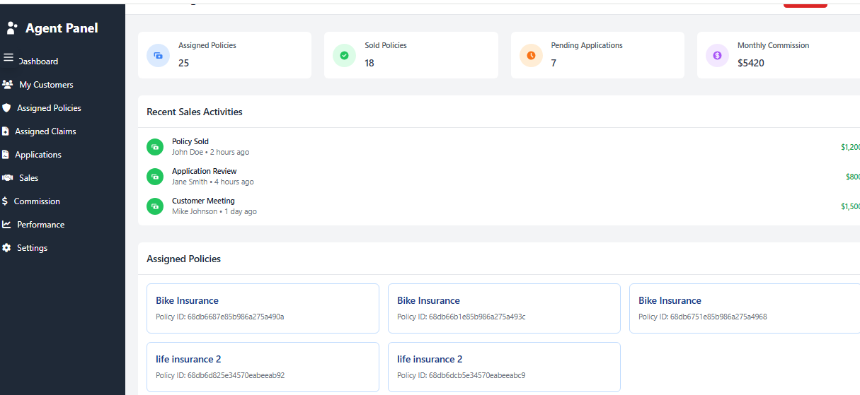
AGENT PORTAL
Important areas of the Project with screenshots

Slide 13
Conclusion
The Insurance Management System developed in this project effectively automates core business processes including policy management, claim submission, payment tracking, and user role handling. By replacing manual workflows with a secure, scalable web application, it significantly improves operational efficiency, reduces errors, and provides timely, accurate information to customers, agents, and administrators. The system’s modular design, use of modern technologies, and focus on security and maintainability make it a strong MVP foundation for future enhancements and real-world deployment in insurance organizations.

Slide 14
Thank You

